Slide 1
ASK ME ANYTHING: A SIMPLE STRATEGY FOR PROMPTING LANGUAGE MODELS
Simran Arora^{1,∗} , Avanika Narayan^{1,∗}, Mayee F. Chen¹, Laurel Orr¹, Neel Guha¹, Kush Bhatia¹, Ines Chami², Frederic Sala³, and Christopher Ré¹
¹Stanford University
²Numbers Station
³University of Wisconsin-Madison
Mahat Sabina 51195901001

Slide 2
Introduction
“ASK ME ANYTHING PROMPTING” is a proposed prompting method
Does collecting multiple effective, yet imperfect, prompts and aggregating them can lead to a high quality prompting strategy?
Develop an understanding of the effective prompt formats, finding question-answering (QA) prompts, which encourage open-ended generation (“Who went to the park?”) tend to outperform those that restrict the model outputs (“John went to the park. Output True or False”)
Using the LLM to transform task inputs to the effective QA format. Later, apply those prompts to collect several noisy votes for the input’s true label.
Prompts can have very different accuracies and complex dependencies so weak supervision, a procedure for combining the noisy predictions is used to produce the final predictions.
AMA is applied to 20 popular language benchmarks and 14 open-source LLMs from 4 model families (EleutherAI [Black et al., 2021, Wang and Komatsuzaki, 2021, EleutherAI], BLOOM blo [2022], OPT [Zhang et al., 2022], and T0 [Sanh et al., 2022]) spanning 3 orders-of-magnitude (125M-175B parameters), demonstrating an average performance lift of 10.2% over the few-shot baseline.
This simple strategy enables the open-source GPT-J-6B model to match and exceed the performance of few-shot GPT3-175B on 15 of 20 popular benchmarks. Averaged across these tasks, the GPT-J-6B model outperforms few-shot GPT3-175B.

Slide 3
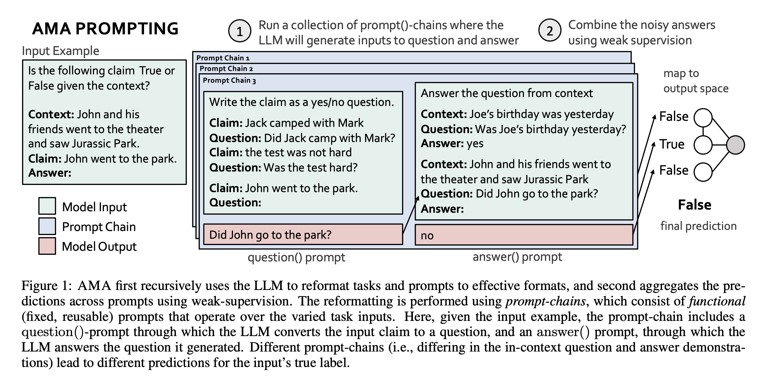

Slide 4
ASK ME ANYTHING (AMA)
Three key questions
How do we get prompts that are of decent quality? We need to understand properties of effective prompts.
How do we generate those effective prompts efficiently at scale?
How do we aggregate the predictions generated by the different prompts reliably?

Slide 5

Challenges and presented Solutions
Effective Prompts
High quality prompts are a precursor to improvements from aggregation
Open-ended format is encouraged, Given a task input, simple structure of forming question based on input and prompting the LLM to answer the question improves the performance across diverse benchmarks tasks
Scalable Collection
Multiple prompts should be obtained to collect votes for an input’s true label which is challenging to scale
Transform task inputs to the effective open-ended question-answering format by recursively using the LLM itself in a fixed two step pipeline. Varying functional prompt-chains is applied to an input to collect multiple votes for the input’s true label.
Prompt Aggregation
Need a strategy that accounts for the varying accuracies and dependencies to make it reliable
Weak Supervision (WS) is applied to prompting broadly for the first time in this work, showing it improves the reliability of prompting with off-the-shelf LLMs and no further training.

Slide 6
Related Work
Several existing works study how to improve the zero-to-few-shot task-transfer abilities of LLMs.
- Training based strategies: Improves prompting performance by training larger models over more or curated data, and for longer [Kaplan et al., 2020, Chowdhery et al., 2022] — or by explicitly fine-tuning LMs over prompts [Wang et al., 2022a, Wei et al., 2022b, Sanh et al., 2022, Ouyang et al., 2022].
- Prompt-engineering: Prompt-engineering is the process of designing natural language specifications of a task, which are used to condition the LLM at inference time. Prior work finds that the prompt format changes the model behavior and proposes particular formats. Some formats are designed-for or evaluated-on a narrow task type, model type, or model size [Wei et al., 2022a, Jung et al., 2022]. Others require users to manually rewrite task-inputs to the prescribed formats on a example-by-example basis in a task-specific manner [Mishra et al., 2021, Patel et al., 2022, Wu et al., 2022]. Creswell et al. [2022], Wu et al. [2022] explicitly decompose the complex tasks into steps, which are each handled in a separate inference-pass.
- Prompt sensitivity: Prior works note the sensitivity of prompting under slight modifications and propose strategies to improve the performance of single prompts [Zhao et al., 2021, Liu et al., 2021]. Prompt aggregation has been applied in several prior works. Many works train models to perform the aggregation and/or to achieve strong results with small LMs [Jiang et al., 2020, Schick and Schütze, 2021, Cobbe et al., 2021, Zelikman et al., 2022, inter alia.]. Self-Consistency Wang et al. [2022b], which requires no training, does not report improvements for small LMs (<10B parameters).
- Weak supervision (WS): WS is a powerful framework that learns the accuracies and correlations of multiple noisy sources and aggregates them to produce weak labels for training data [Ratner et al., 2017, 2016, 2018, Varma et al.,2019, Fu et al., 2020]. WS has been applied to prompting in the context of distilling a LLM by aggregating the outputs of hand-curated prompts into a labeled dataset and training a smaller model on it [Smith et al., 2022].

Slide 7
ASK ME ANYTHING PROMPTING
1. How do we get prompts that are of decent quality?
Standard prompt formats
(1) questions that restrict the model output particular tokens (“John invited Mark to come watch Jurassic Park. Output True or False?”);
(2) cloze-questions which ask the model to fill in the remaining text (“John invited Mark to come watch Jurassic _” and using the LLM to fill-the-blank, “Park”);
(3) traditional (yes-no, Wh) free-form questions (“Where did John invite Mark?”)

Slide 8
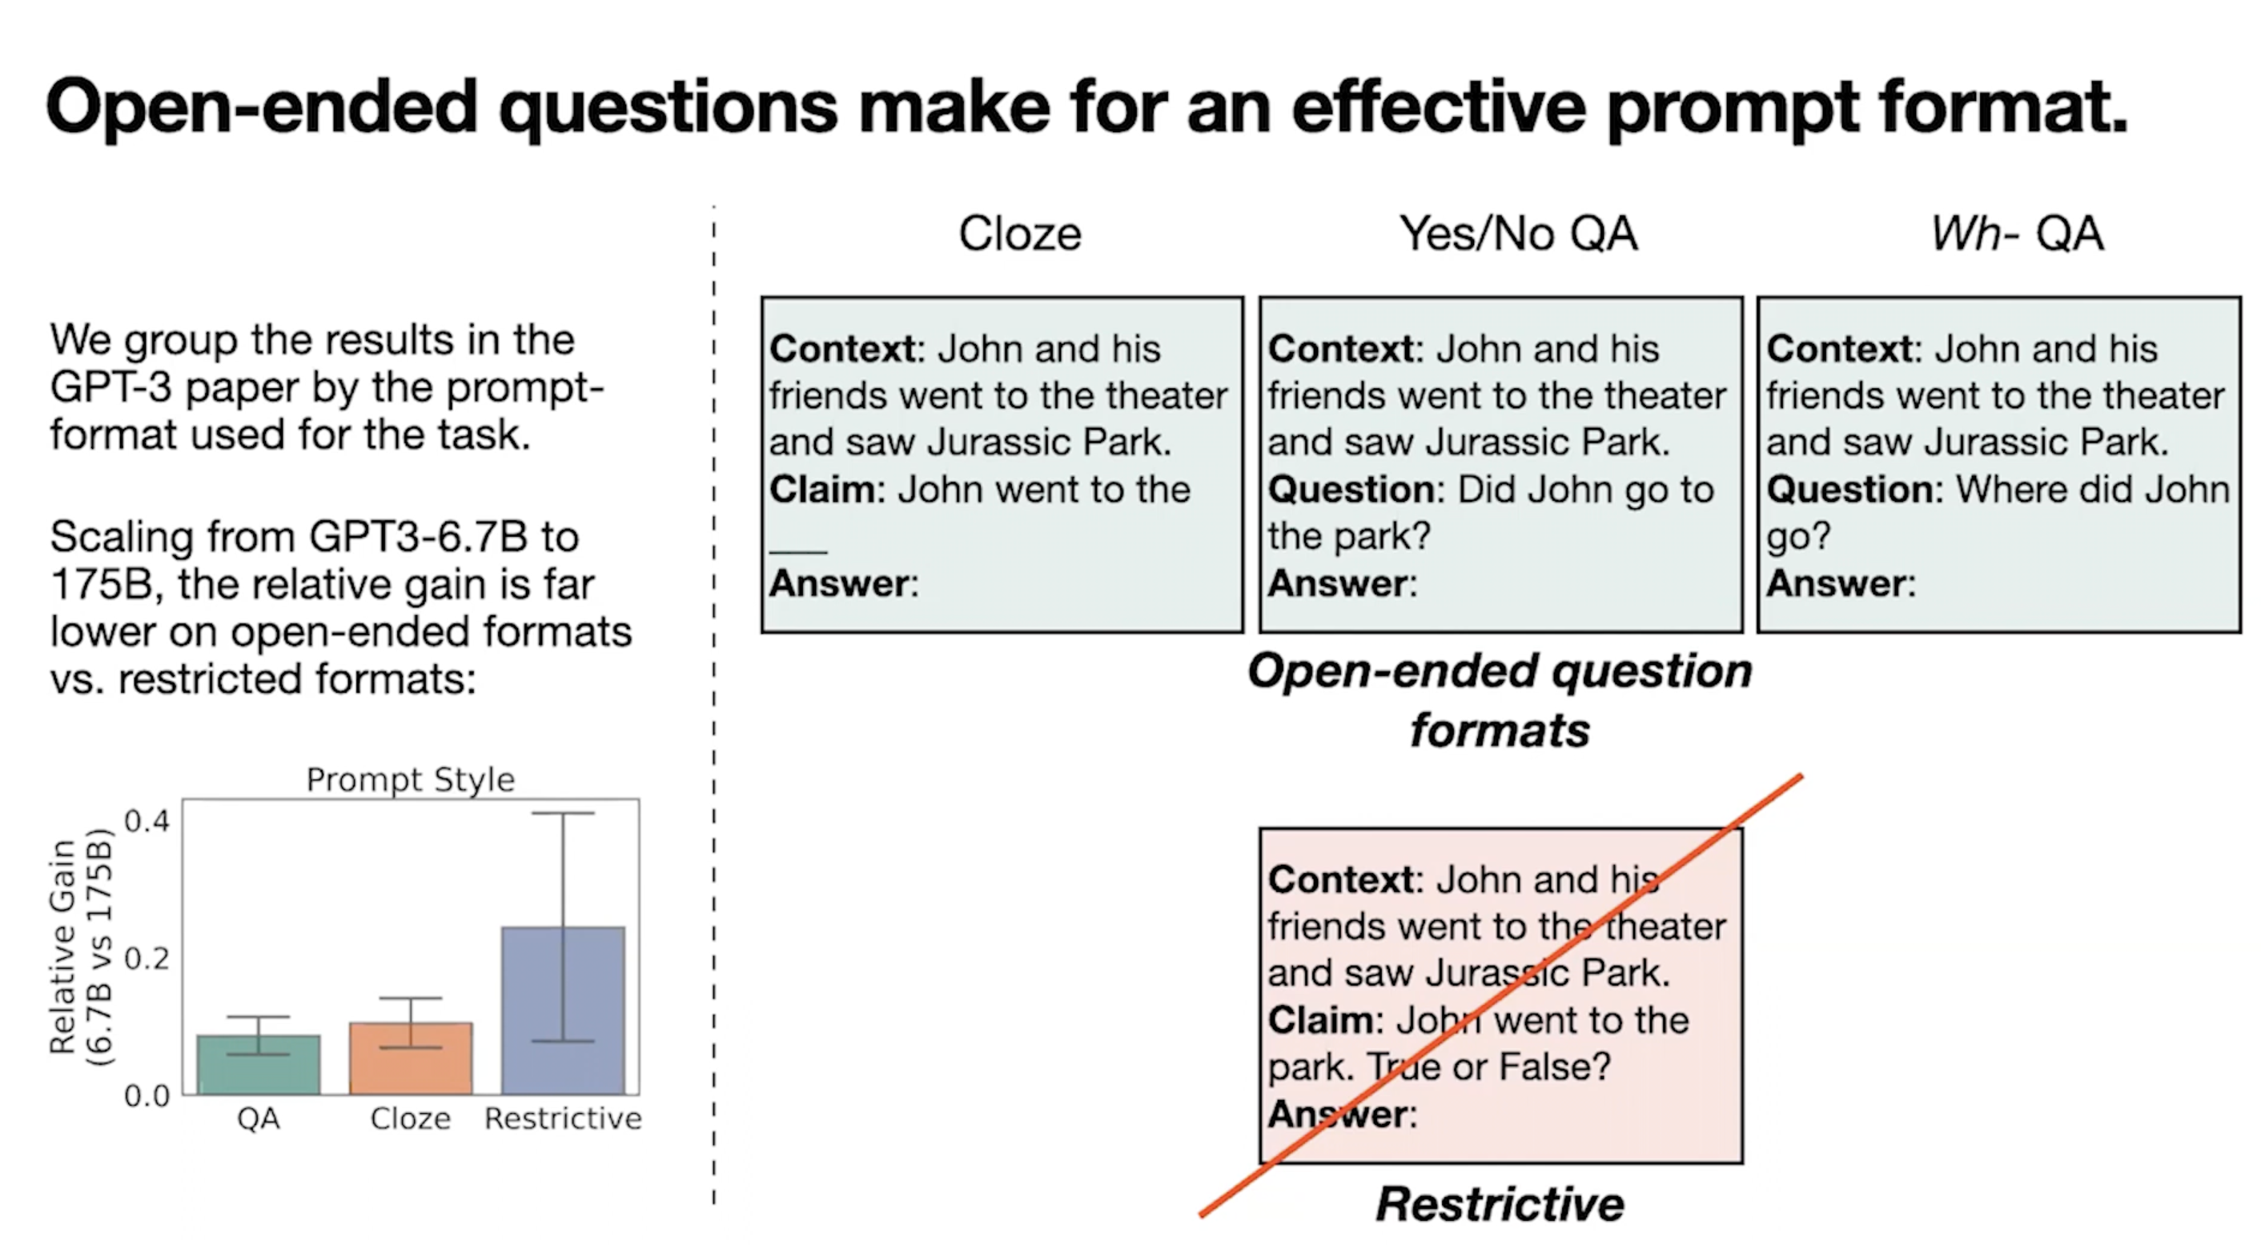
Observations
1. Open-ended prompts appear to outperform restrictive-prompts.
2. The use of open-ended questions over restrictive-prompts can increase the difficulty of mapping open-ended answers to valid output classes.

Slide 9
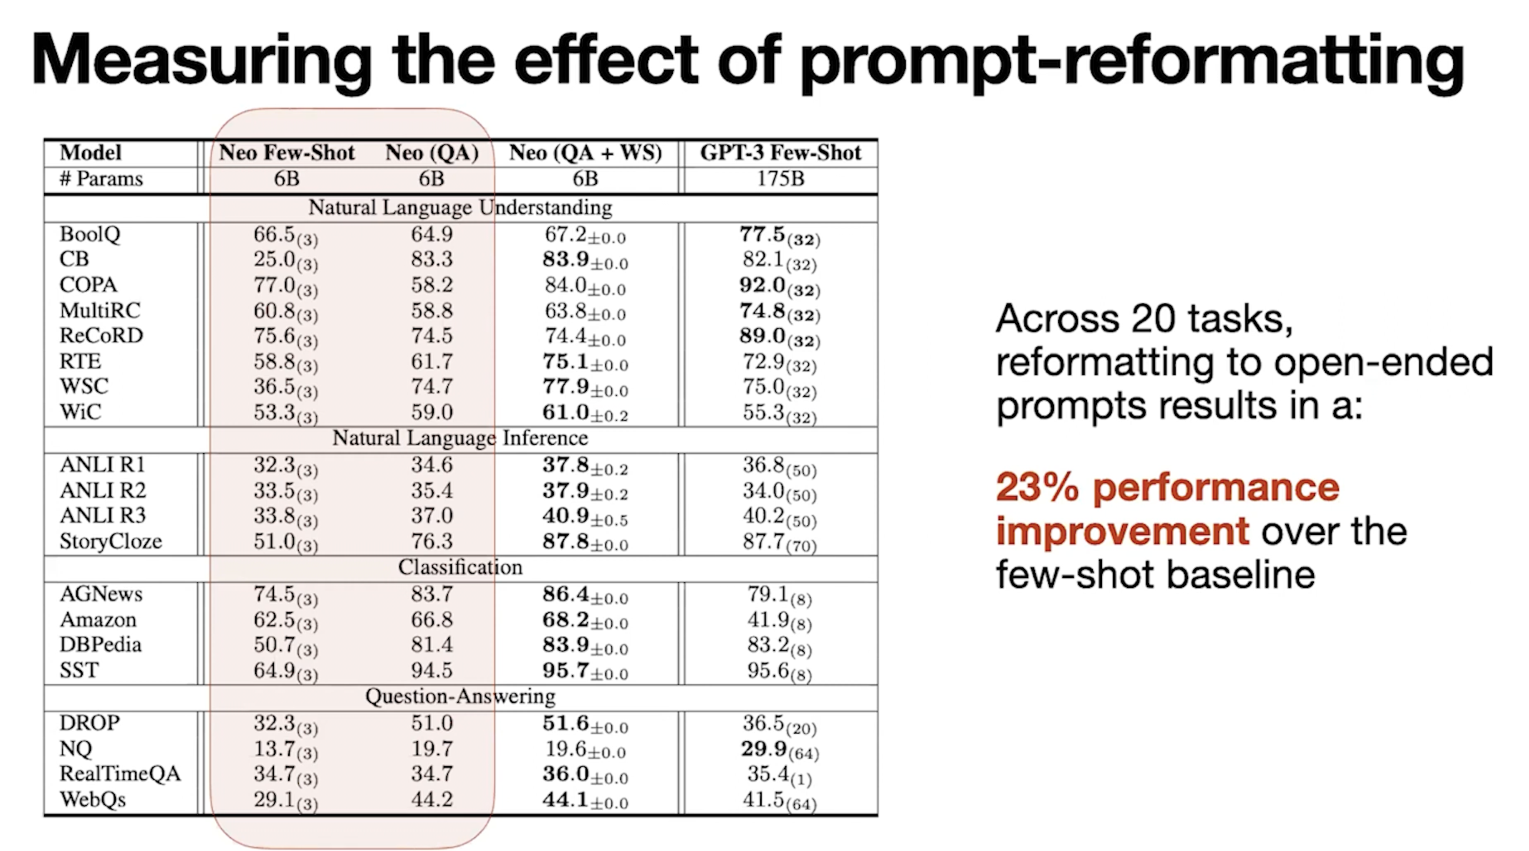

Slide 10
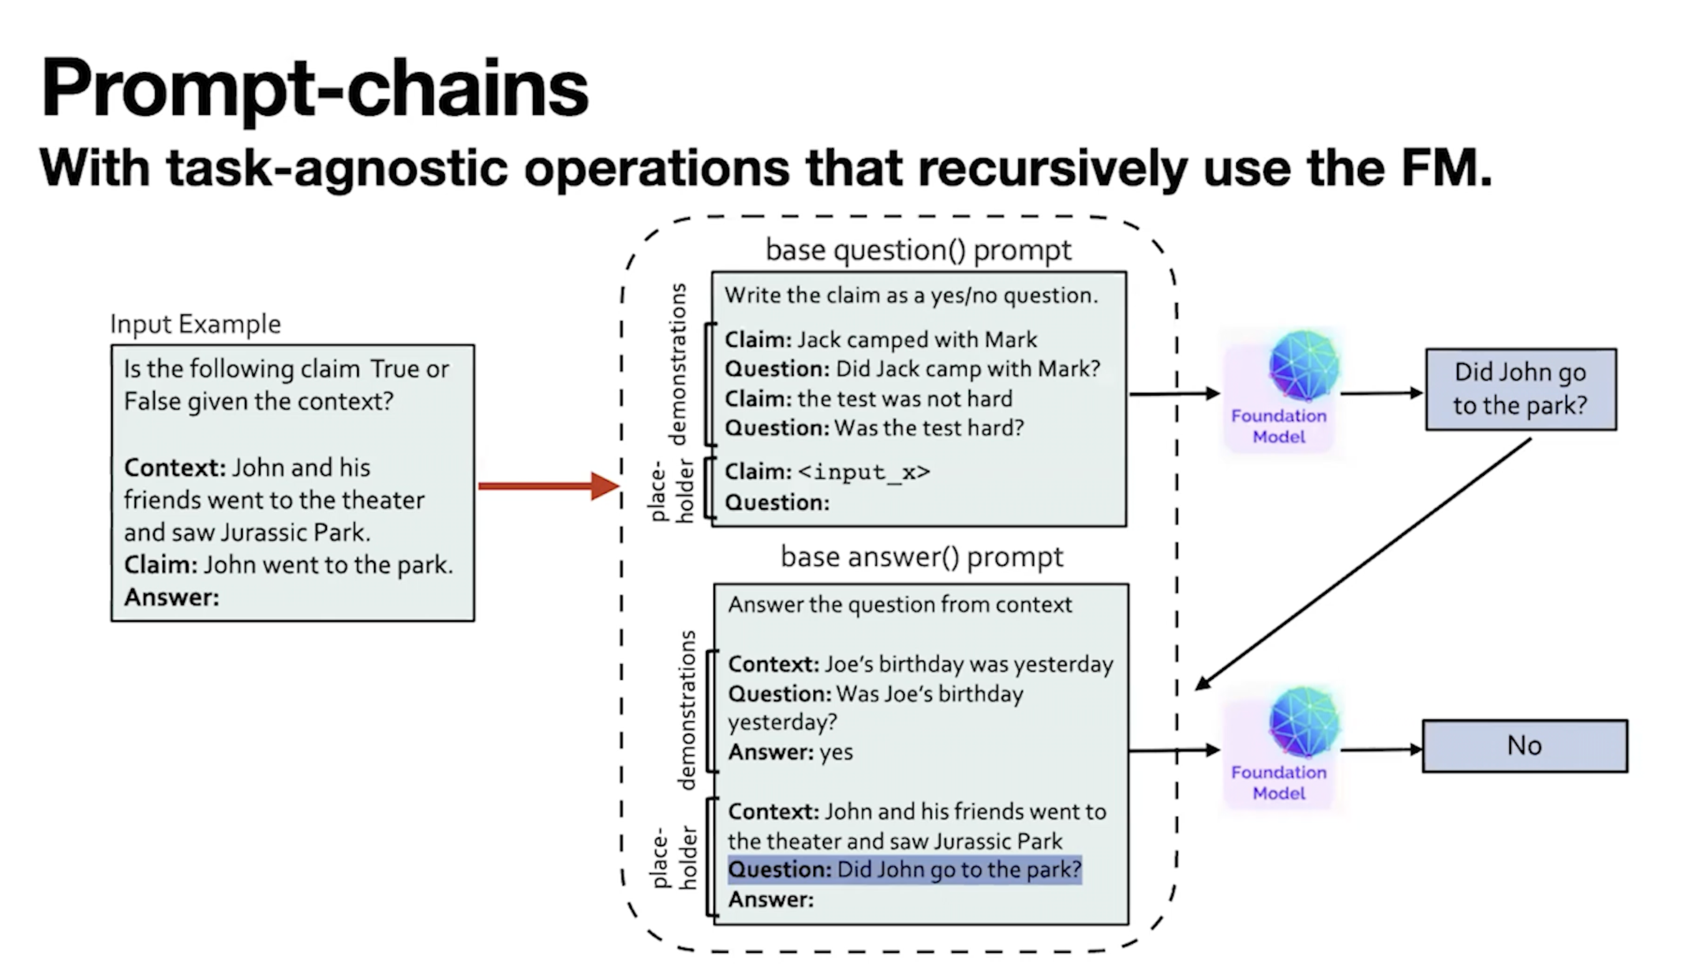
ASK ME ANYTHING PROMPTING
2. How do we generate those effective prompts efficiently at scale?
Two functional prompts used in AMA:
(a) question(): x → q generates a question q (such as “Did John go to the park?”) from an input x (“John went to the park.”). question() prompts simply contain demonstrations of how a statement can be transformed to an open-ended question.
(b) answer(): q → a applies the question generated by (a) to the context of x to produce intermediate answers a (such as “No” or “theater”). The answer() prompts contain demonstrations of how to answer a question (optionally) given some input context.
To vary the style of open-ended prompt questions, question() and answer() prompts that produce and answer either Yes/No, Wh, multiple-choice, or cloze- questions is constructed.

Slide 11
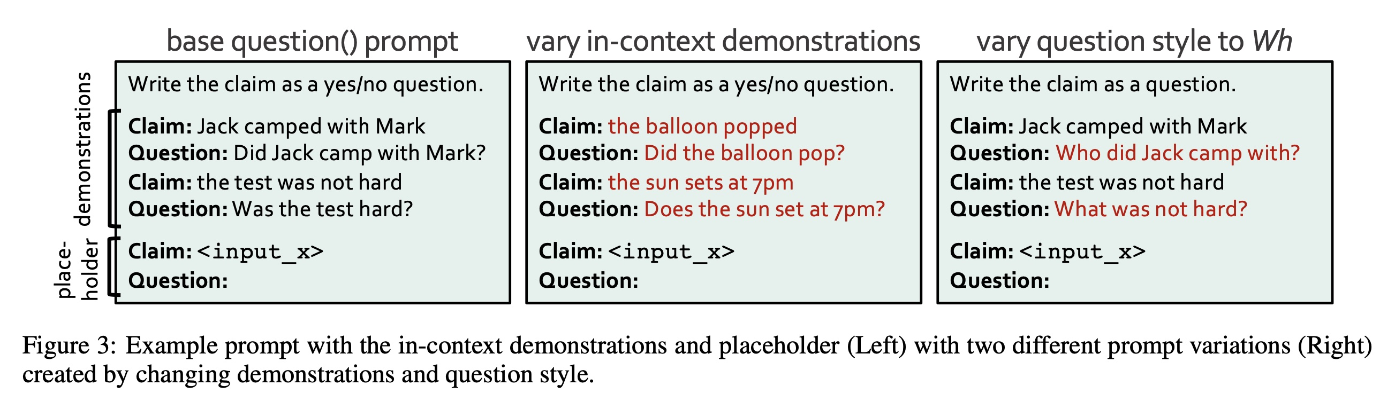
- Multiple prompts-chains is produced to obtain multiple prediction per example, then aggregate over the collection is done.

Slide 12
ASK ME ANYTHING PROMPTING
3. How do we aggregate the predictions generated by the different prompts reliably?
Baseline observations for P on CB, RTE and WSC
(1) PT: varying the prompt template with no overlap in the in-context examples
(2) PE : varying the in-context examples for a fixed prompt template, all with | P | = 5.
Observed the following properties on P:
Varied overall accuracies: While prompts in PE may seem more similar than those in PT, the gap between the best and worst pi ∈ P is large in both cases — 12.1% for PE and 9.6% for PT.
Varied class-conditional accuracies [Zhao et al., 2021]: Beyond overall prompt accuracy, the average variance of class-conditional prompt accuracies is 9.7% across the tasks and baselines.
Highly-correlated outputs: Prompt predictions have dependencies among each other. The Jaccard index over error sets averaged across tasks is 42.2 for PE and 39.9 for PT. For reference, two prompts that produce i.i.d. errors and have 60% accuracy each would have a score of 0.25.
Majority Vote (MV) tends to do better than using one prompt, but it weights all prompts equally and treats them independently hence it may be sufficient over certain collections of prompts but is not reliable across general P that may exhibit above three properties.

Slide 13
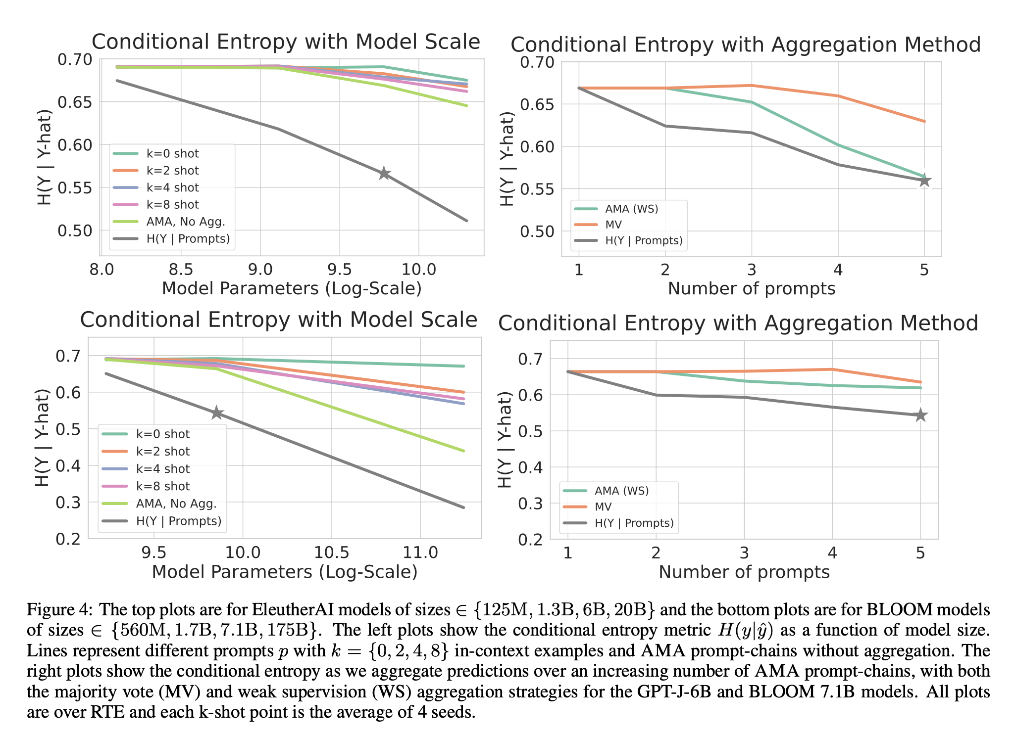
- AMA outperforms k-shot baselines with expected scaling in terms of both individual prompt()-chain quality and their quantity.
- considering gap term H(y|yˆ) − H(y| P(x)), it shows MV is insufficient as it compresses information from P(x) according to a specific construction of Pr(y,P(x)), for which pi(x) ⊥ pj(x)|y for all i, j ∈ [m], and Pr(pi (x) = c|y = c) for c ∈ Y is a single better-than-random constant across i and c. When the true distribution is vastly different—as is common—this misspecification results in a large gap between the optimal H(y|P(x)) and H(y|yˆMV) in Figure 4 (Right).
Weak supervision can improve φ over the standard MV baseline to reduce the information loss H(y|yˆAMA) − H(y| P(x)).

Slide 14
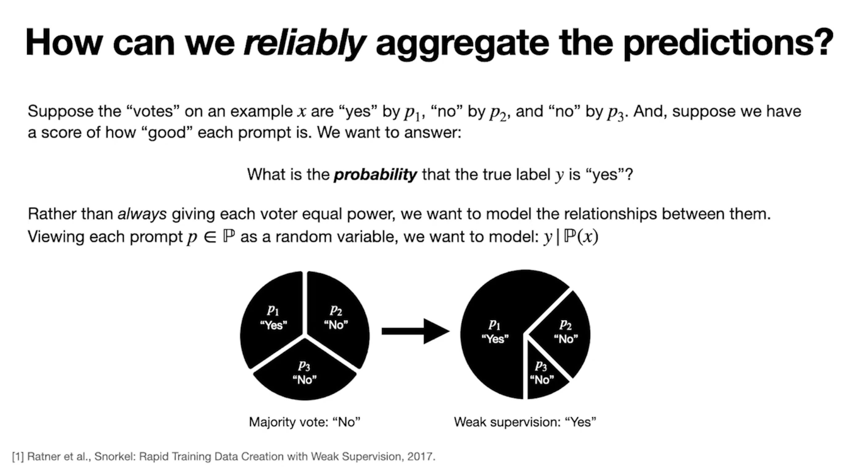

Slide 15
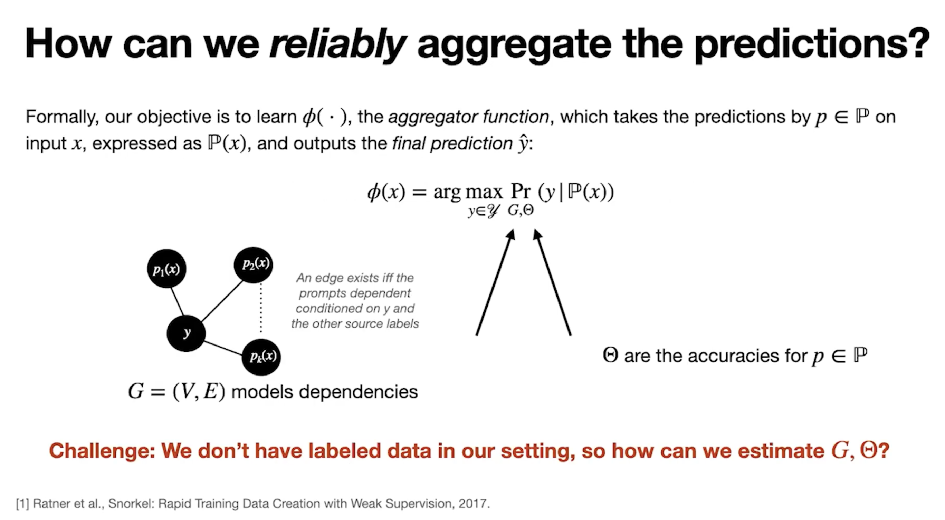

Slide 16
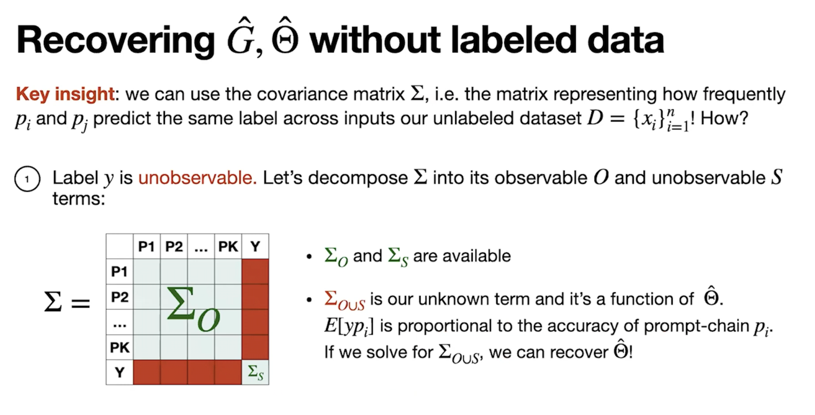

Slide 17
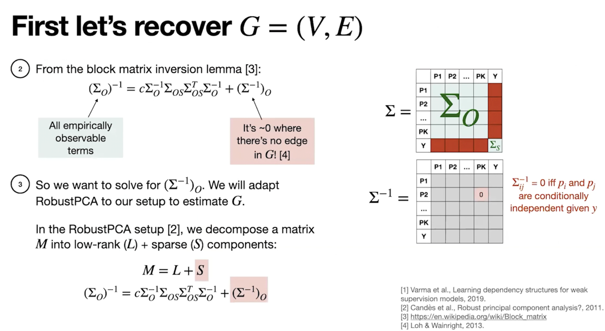

Slide 18
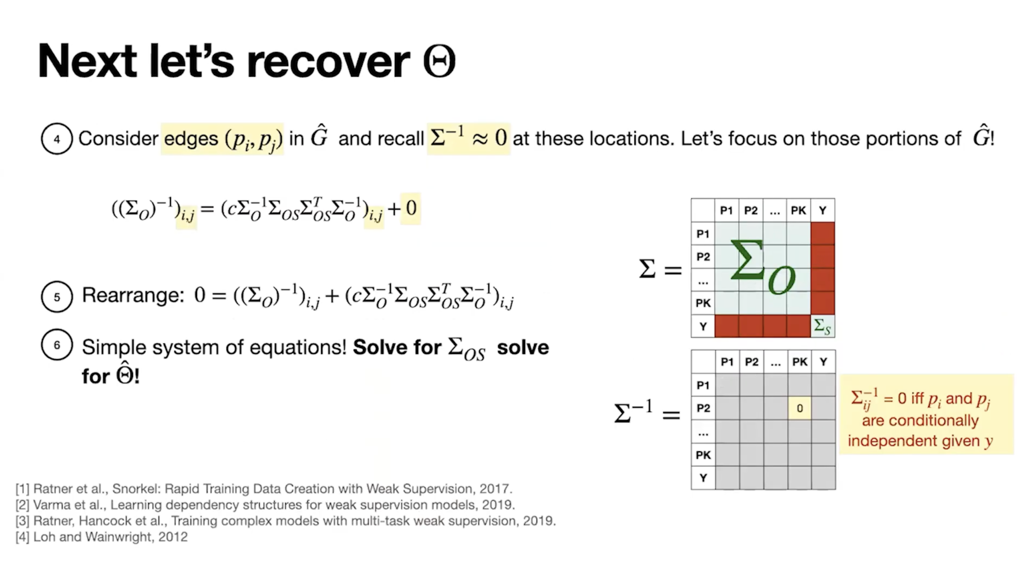

Slide 19
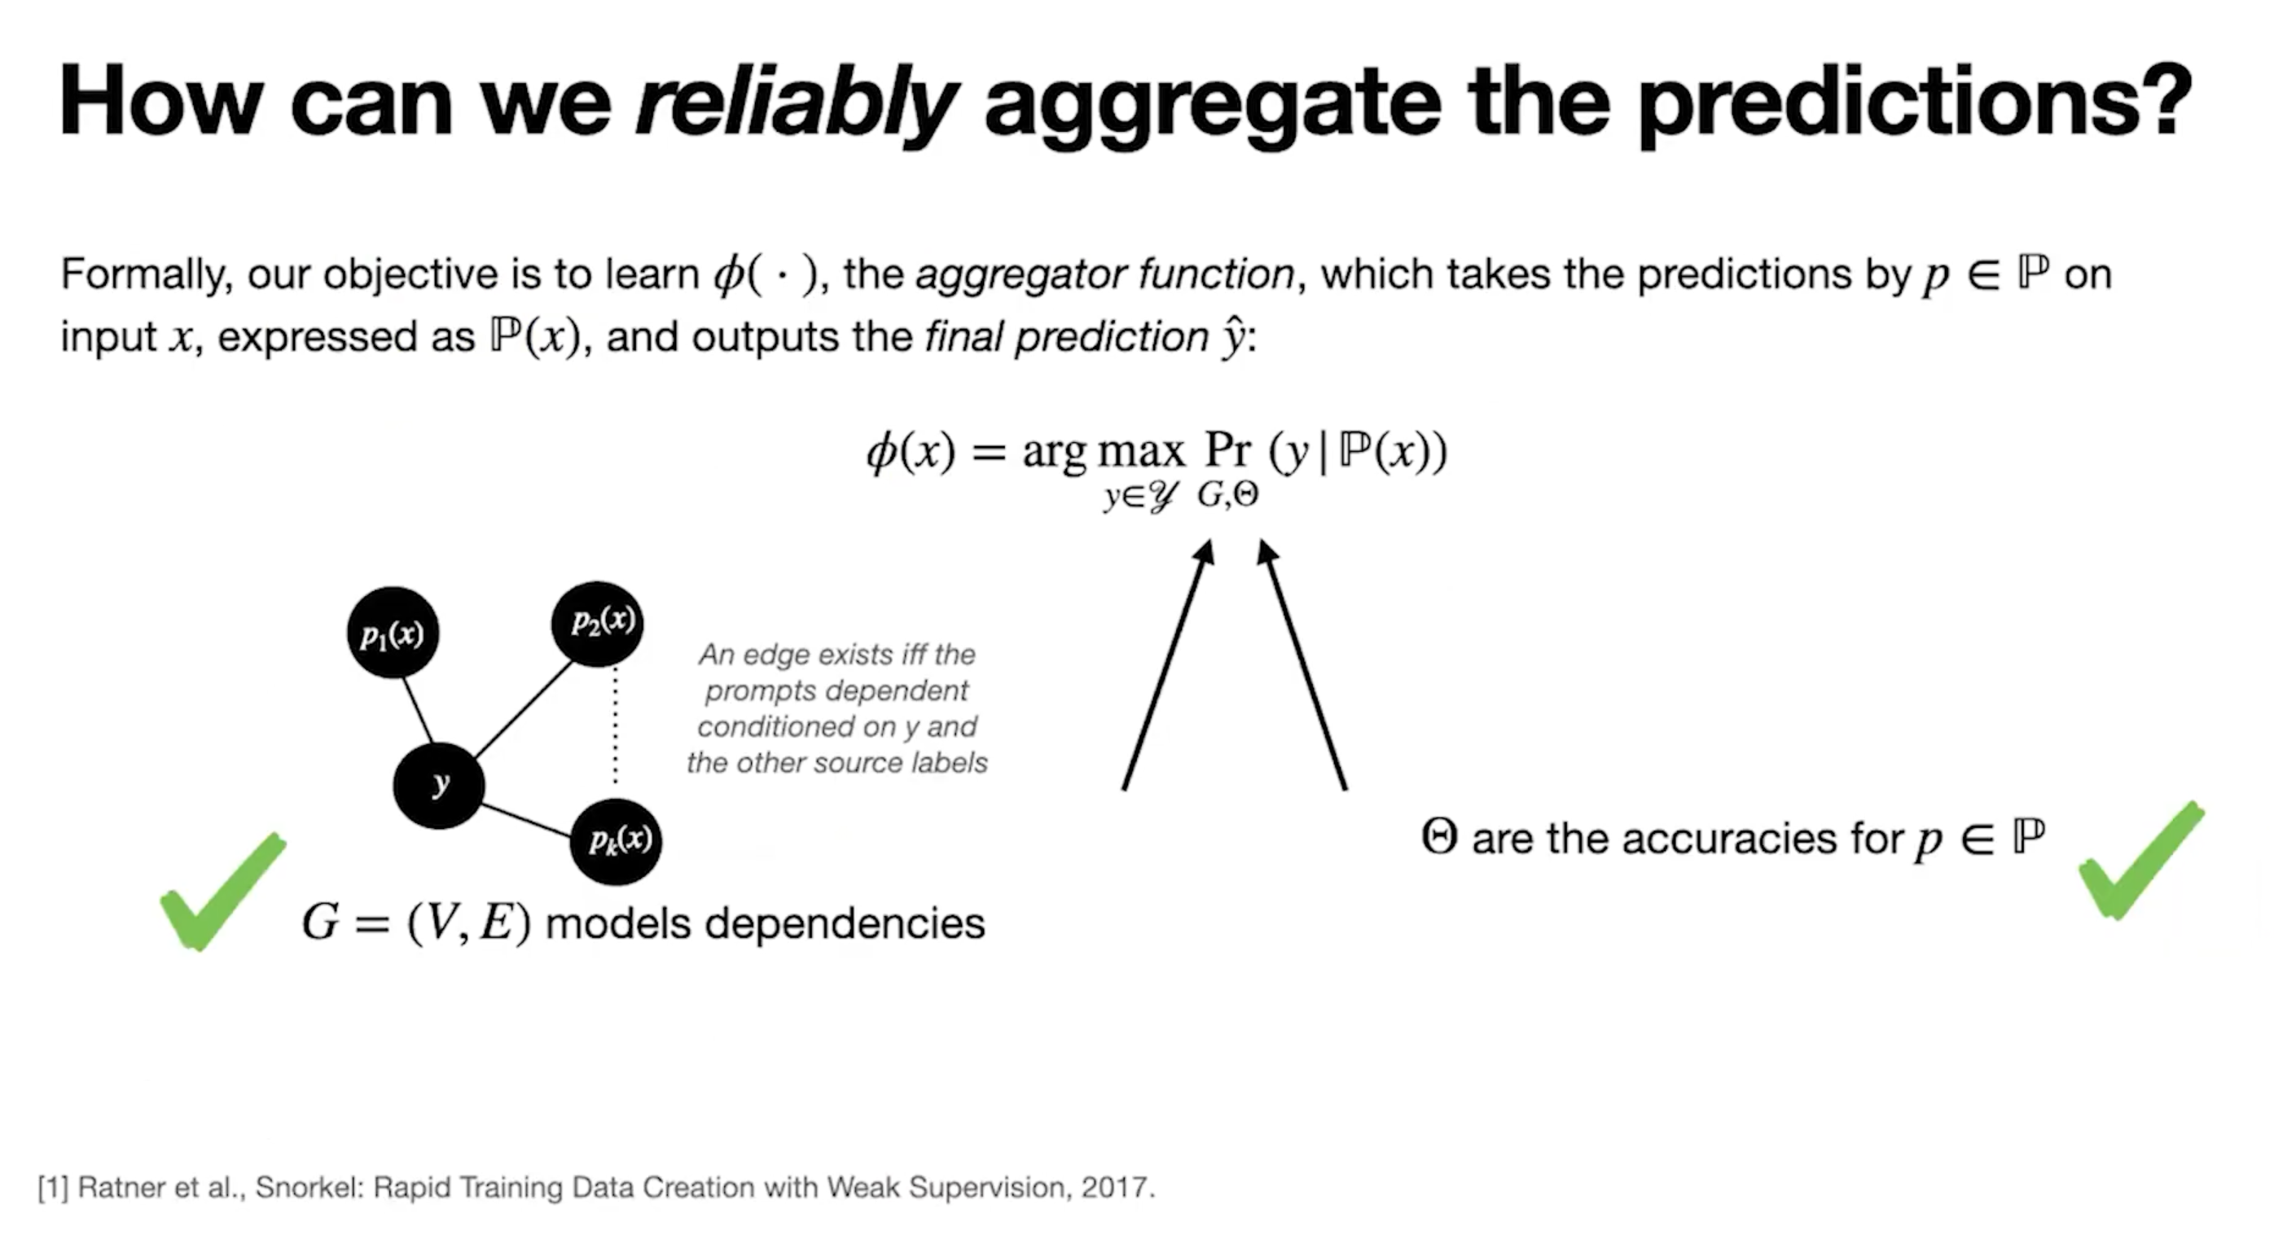

Slide 20
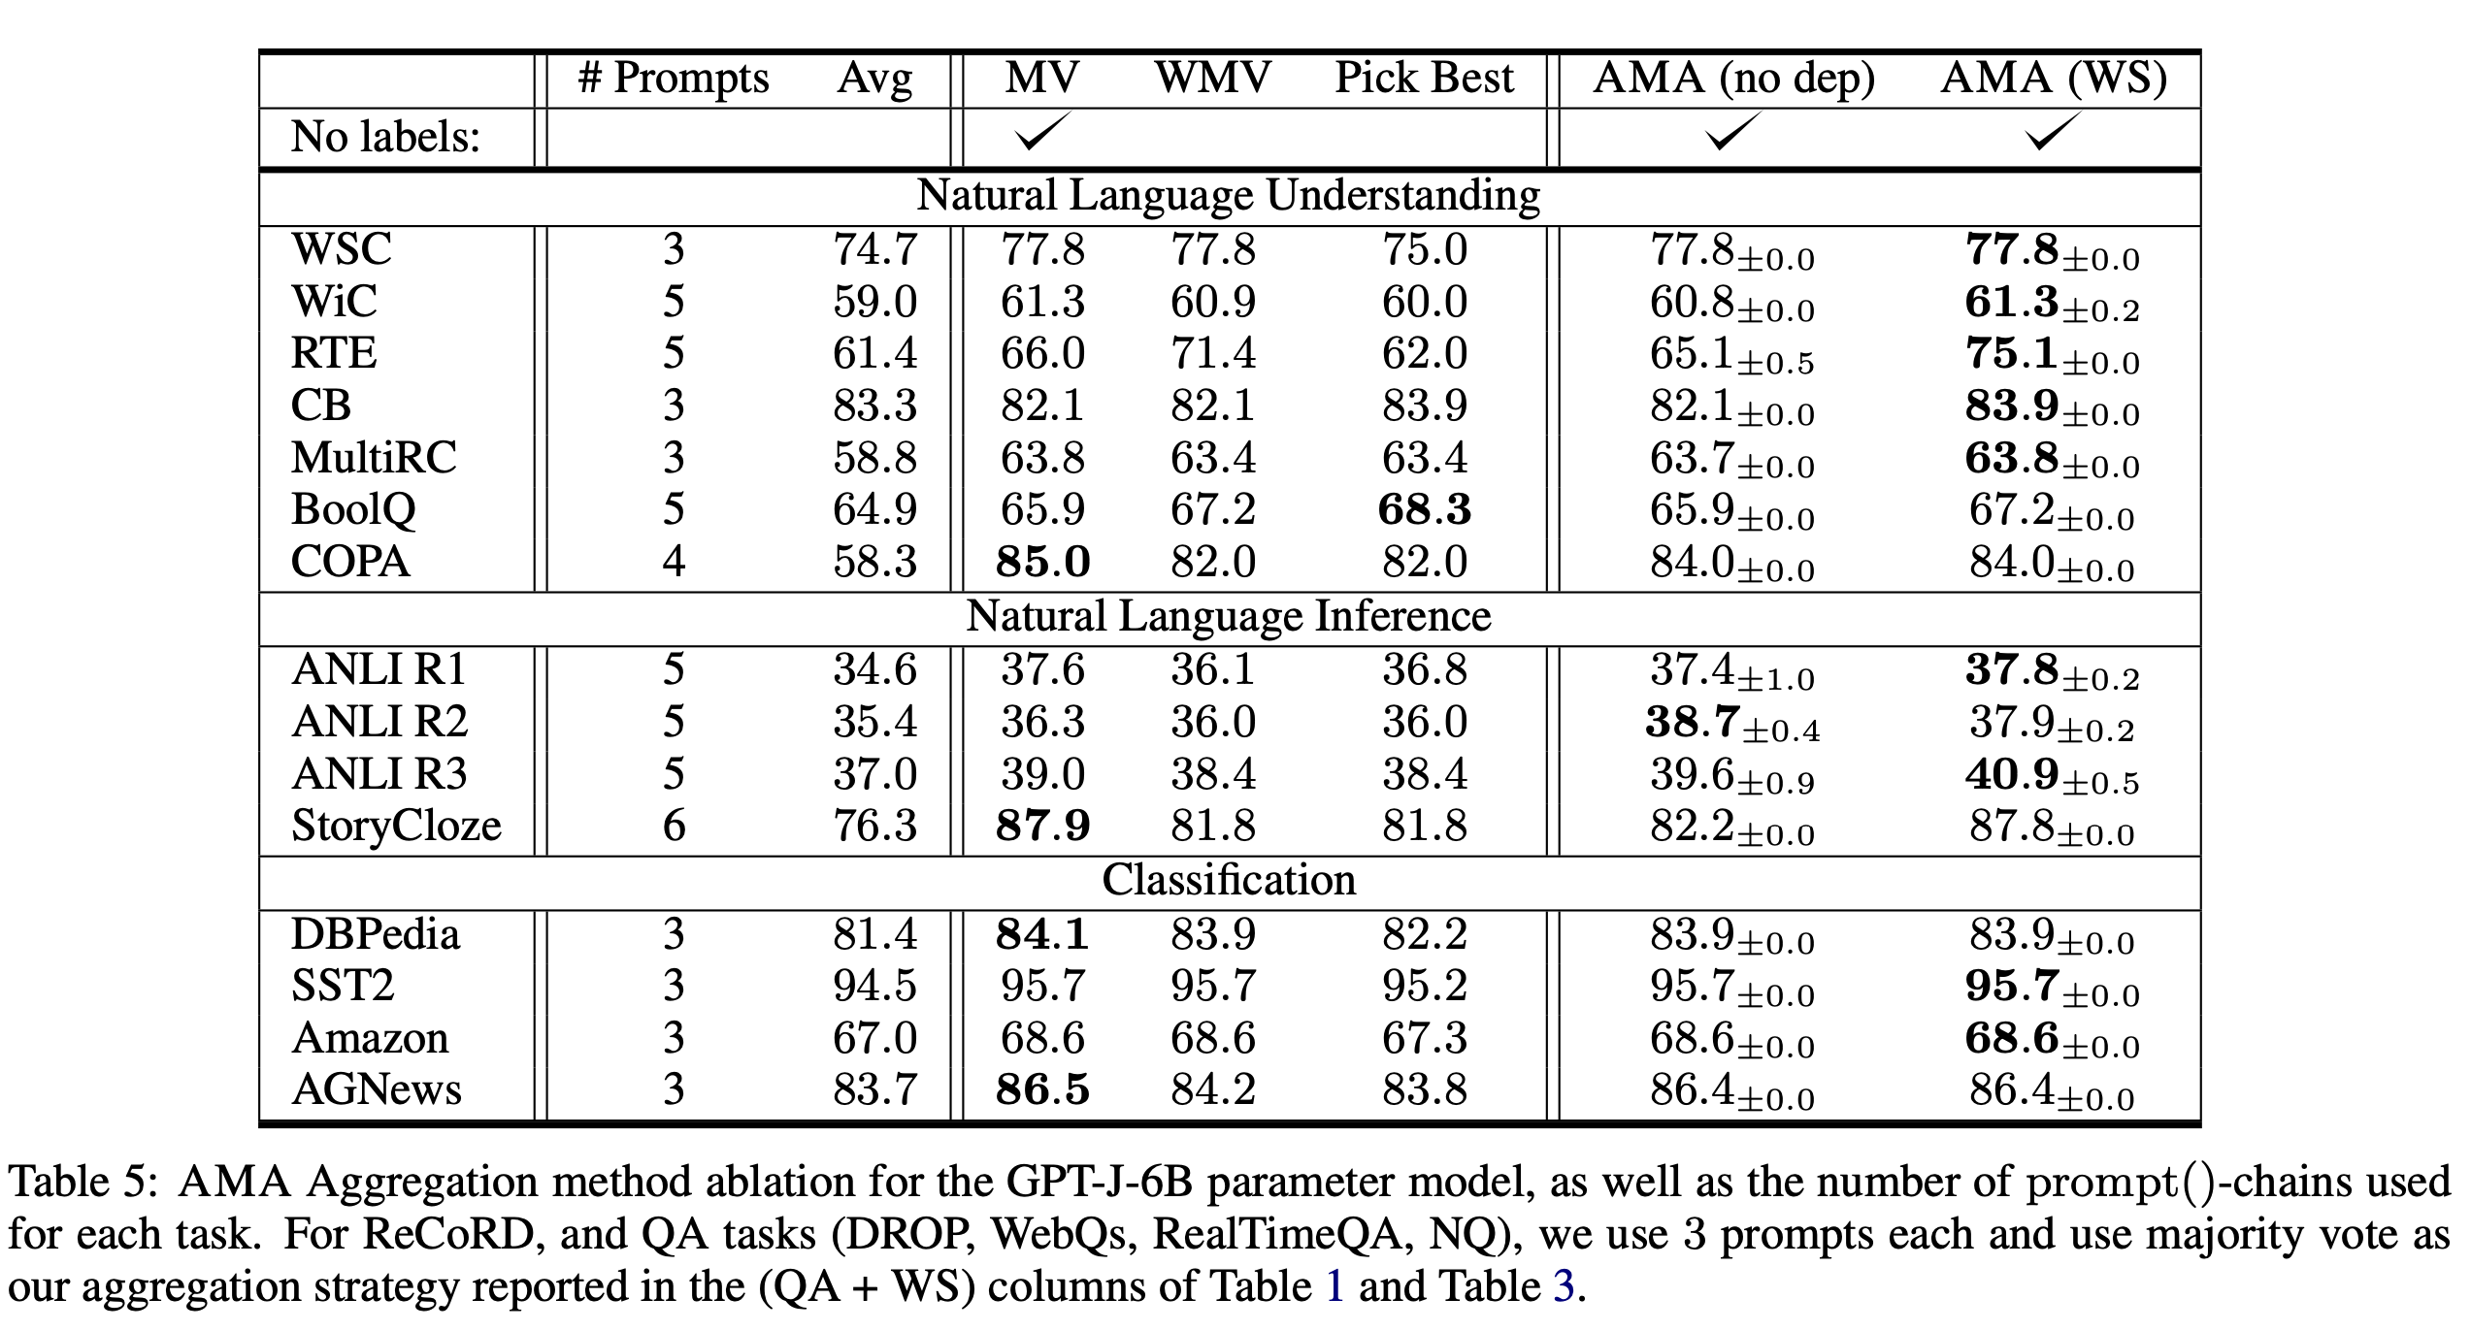
Evaluating AMA’s aggregation strategy
AMA can achieve up to 8.7 points of life over majority vote, improving reliability!

Slide 21
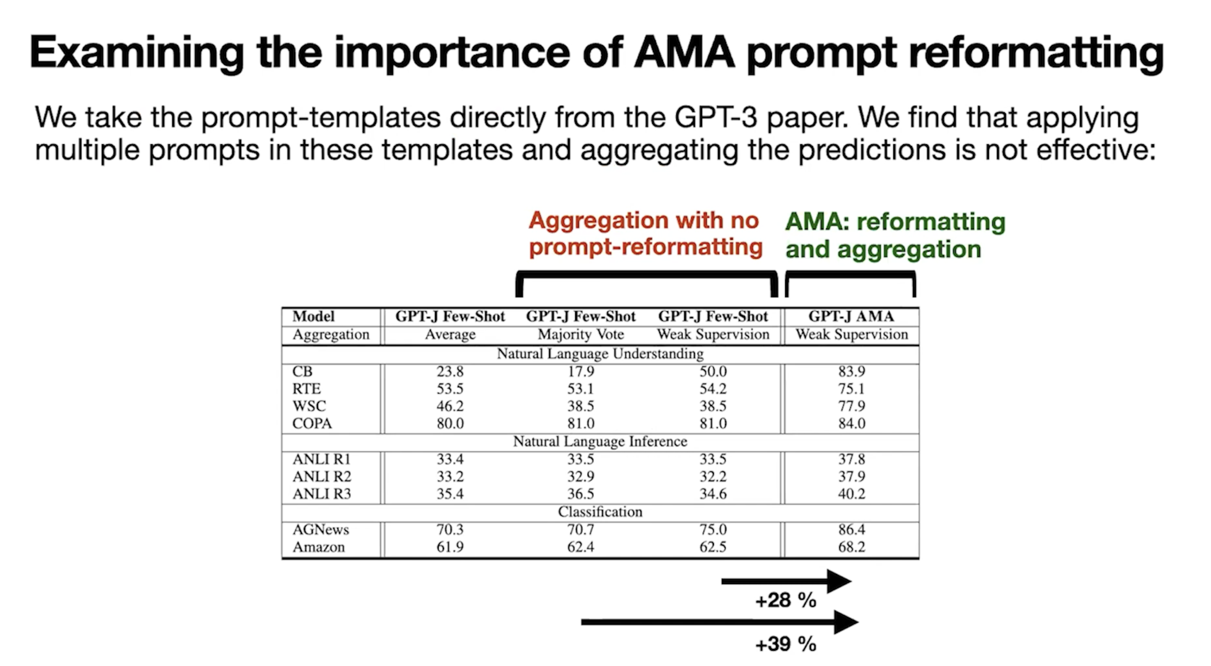

Slide 22
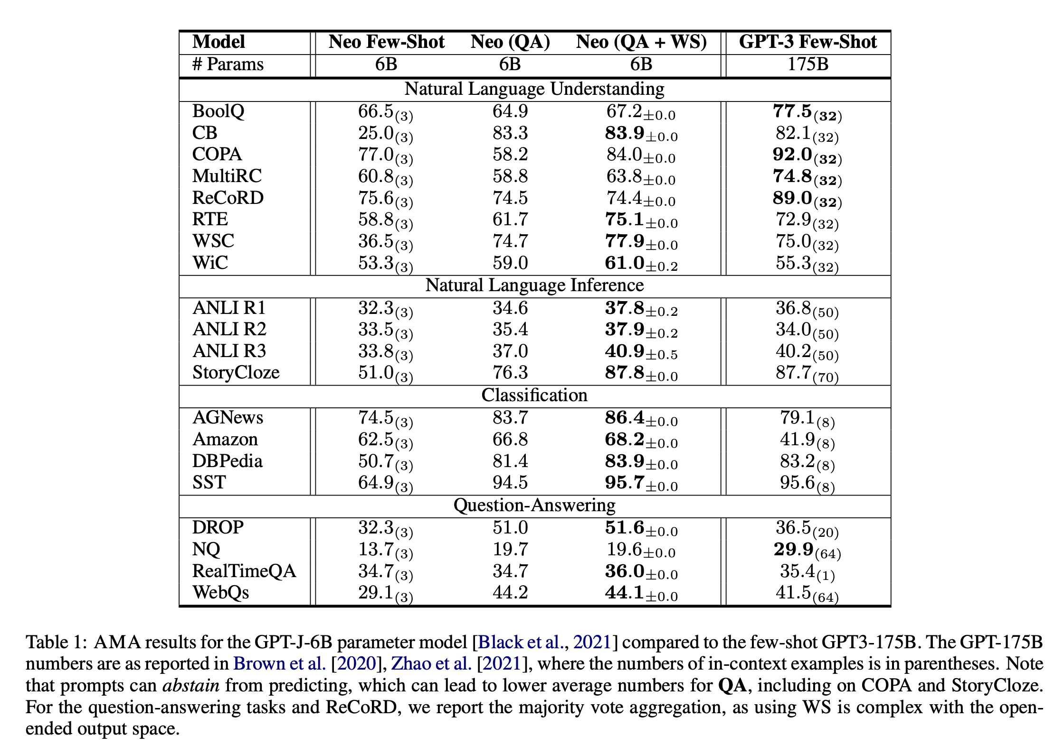
Results

Slide 23
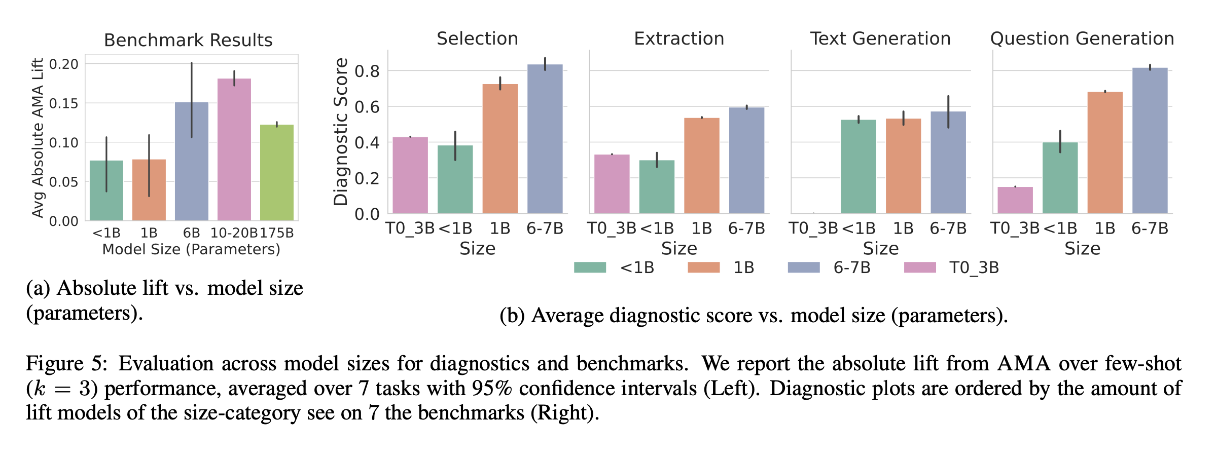
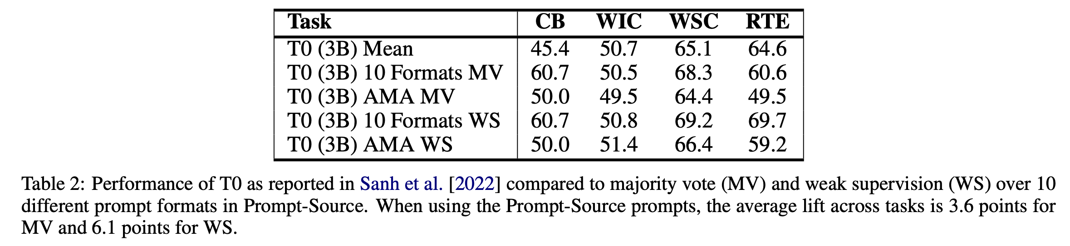
Results

Slide 24
Conclusion
- ASK ME ANYTHING PROMPTING (1) scalably obtains multiple prompts given a task input and (2) combines the intermediate answers to these prompts using weak supervision to give the final prediction.
- The steps in AMA stem from the observations on the effectiveness of open-ended questions over restrictive prompts, and the ability to model the varying accuracies and dependencies across a collection of prompts using weak- supervision.
- AMA provides lift across four language model families and across model sizes ranging from 125M-175B parameters.
- AMA enables a 30x smaller LM to exceed the average performance of few-shot GPT3-175B averaged across 20 popular language benchmarks

Slide 25
Thank You !

